Slide 1

WELCOME TO
PEARL UPPER ELEMENTARY
Mrs. Mangum: Language Arts & Social Studies
Mrs. Hoard: Math
Mrs. Gross: Science

Slide 2
OUR MISSION
The Mission of Pearl Public School District is to prepare each student to become a life-long learner, achieve individual goals, and positively impact a global society.

Slide 3
Arrivals/Dismissals
Arrival –
  Students may arrive at school between 6:55-7:30 am.
  Students arriving after 7:30 am are considered tardy.
  We begin classwork as soon as students enter the classroom; therefore, it is very important for students to be at school on time.
Early Dismissal/Checkout–
  If you need to check your child out early, please arrive before 1:30 (Monday, Tuesday, Thursday, Friday) and before 1:00 (Wednesday).
  A valid photo ID is required for dismissals. Only people listed as emergency contacts in Active Parent will be allowed to
  check out a student.
  Students must be at school 63% of the day
to be counted present
Be sure to send an excuse with your child
after every absence.

Slide 4
Attendance Policy
Please read pages 6-8 of the student handbook for the district attendance policy.
Field Trips – page 75
“No student with 10 or more unexcused absences or 20 combined tardies/check-ins/ checkouts will be allowed to go on field trips.”

Slide 5
Birmingham Field Trip
Date: April 5, 2024
More information will be provided
at Report Card Conferences.

Slide 6
Transportation
Car riders must be dropped off and picked up at the back of the building. Please stay in line and do not go around cars that are parked waiting to drop off or pick up students. Students must sit on the passenger side of the car.
Car riders must arrive before 7:20 a.m. to eat breakfast at school.
Students must ride the same bus to and from school. (District Policy)
Requests for permanent transportation changes must be submitted to the school office in writing for
approval. Temporary transportation changes will
NOT be allowed (Student Handbook pg. 18)
Please check book bags for items that do not need to come to school.

Slide 7

Transportation Text Alerts
To receive text alerts related to Pearl Upper bus routes: Text @busupele to 81010
These alerts will let you know about substitute buses and late buses.

Slide 8
Lunch Reminders
Student lunch price is $3.00.
Parents are always encouraged to eat lunch with their children. ($4.00 for guests)
All outside food must be in non-labeled packaging. (Ex. No McDonald’s bags/wrappers)
Any treats sent to school must be store-bought with an attached nutritional label (no homemade goodies).

Slide 9
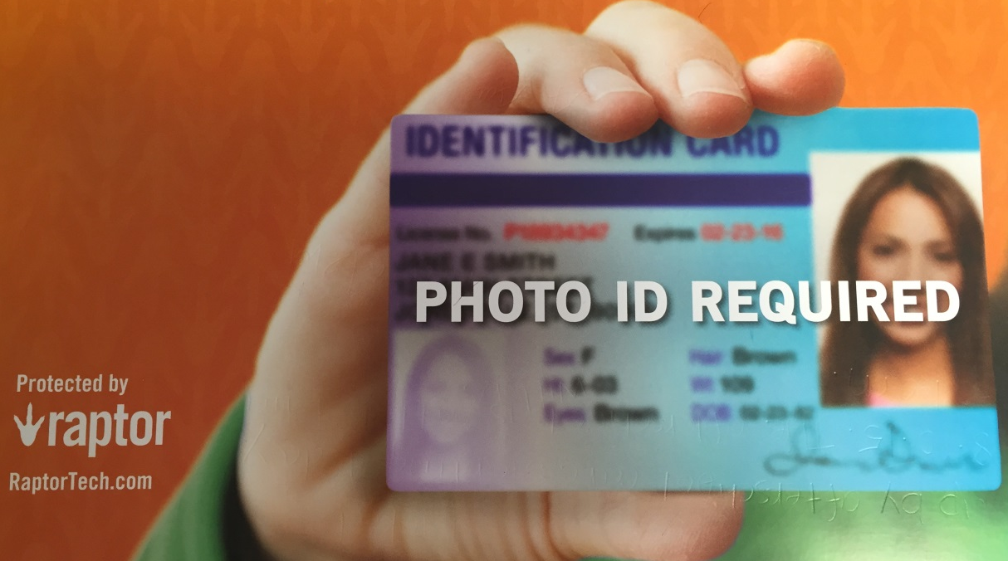
School Visitation
All Pearl Public Schools are using the Raptor Visitor Management System. This system scans valid, government-issued IDs and instantly screens out registered sex offenders.
In order to better protect our students, visitors, and staff, all visitors and field trip chaperones will be required to show a valid, government issued ID.

Slide 10
Dress Code – Pg. 80-81 of Student Handbook
1. Any clothing or accessories that distract from the educational process are unacceptable.
Examples of inappropriate attire include, but are not limited to, the following:
oversized hoodies; (some girls have been wearing hoodies that are longer than their shorts)
head covering of a nonreligious form, hats, caps, and bandanas;
sunglasses;
clothing with chains, rings, hooks;
pajama tops or bottoms;
cut-off/fringed shorts;
shoes with no backs (bedroom slippers, flip-flops, slides), wheelies, cleats, or light-up shoes;
sleeveless shirts worn by males;
sagging or oversized clothes;
pants with hem worn below the heel of the shoe.

Slide 11
Dress Code – Pg. 80-81 of Student Handbook
Hairstyles should not distract from the educational process. Hair must be styled in order for the eyes to be seen by school personnel, and style or color may not cause classroom disruptions.
No clothing (or accessories) containing advertisement for alcohol, drugs, or tobacco or that includes obscene/questionable/disruptive printing or gang/cult symbols should be worn to school.
All pants must be worn at the waist (no sagging).
No hoods are to be worn in the building.
No midriffs, halter tops, tank tops, racerback tops, tube tops, off-the-shoulder tops; or low neck/back clothing will be allowed. Dresses or blouses must have a minimum of 2” strap with a tight fit around the arms and neck. Back and midriffs must remain covered when standing or seated.
.

Slide 12
Dress Code – Pg. 80-81 of Student Handbook
Students may wear pierced devices such as earrings only in the ear.
All fasteners designed for use with an article of clothing must be used appropriately at all times.
Shorts and skirts may be no shorter than the point on the leg which the fingertips strike when the arms and hands are fully extended, and the arms are allowed to hang loosely by the side.
No grooming instruments (rollers, picks, brushes, combs) will be allowed in the hair while at school.
Clothing (for example blue jeans) must not have holes that expose skin or any undergarment.
There will be no sharing of makeup or any other personal hygiene items.
Clothing considered and intended as underclothing (including white t-shirts) must not be worn as outer garments.

Slide 13
Dress Code – Pg. 80-81 of Student Handbook
Leggings, jeggings, tights, and spandex attire will only be allowed for girls wearing them under long shirts, skirts, or dresses that are mid-thigh length (front and back).
No pants should be tied at the bottom by any device, including rubber bands, shoe strings, etc.; pants may not be tucked into socks.
Violations of Dress Code
If a student is in violation of the dress code, a parent will be called to bring appropriate clothing or appropriate items may be loaned from the school closet.

Slide 14
Discipline Policy
  Green = good behavior
  Yellow = no talking table, miss 5 minutes of recess
  Orange = no talking table, miss half of recess
  Red = no talking table, miss all of recess
  Purple = office/parent contact
Serious issues go straight to office
Planners will be marked by teacher each day to note behavior

Slide 15

Signed Papers
Sent home every Monday
Must be signed and returned on Tuesday
Review newsletters attached to signed papers.
Check folder and remove any notes
Homework
Check weekly newsletters and planners daily for homework assignments.

Slide 16
Active Parent
All parents have an Active Parent account. Please use this site to check student grades regularly.
Grades will be updated 1 time per week.

Slide 17
School and Teacher Websites
Please visit our district, school, and teacher websites often. On these websites, you will find important updates, a school calendar, newsletters, and a variety of valuable information and resources.
www.pearlk12.com

Slide 18
Our Classroom Schedule
7:00-7:40: Breakfast and Morning Work
7:40-8:20: Specials
8:25-9:10: Anchor time
9:15-10:30: 1st period
10:30-12:40: 2nd period
  Recess (10:35-10:57 – Mangum and Hoard)
  Recess (11:40-12:02 – Gross)
  Lunch (11:15-11:40 – Gross and Mangum)
  Lunch (11:23-11:48 – Hoard)
12:40-1:55 (1:15 on Wed.): 3rd period
1:55-2:00 (1:15-1:30 on Wed.): Pack up
2:00 (1:30 on Wed.): Dismissal

Slide 19
Math
iReady (45 minutes weekly) and Ready math textbooks/workbooks to supplement the CCRS standards
Composition notebook will be used as a Math Journal that will have notes and handouts from class.
Students need to know Decimal Place Value Location.
Homework- normally Monday through Thursday nights – I will give out the Essential Questions on Mondays and choose which questions they need to go over each night.
2 – 3 grades a week
Students are encouraged to take their journals
home each night.

Slide 20
Language Arts/Social Studies
Magnetic reading workbook and reading journal
Short stories with comprehension questions and writing prompts (Some of them will be graded.)
Vocabulary will be given for each lesson
2-3 grades a week (at least one ELA/sometimes two and one S.S. grade)
One Unit Test will be given every term. (Sometimes the benchmarks will count as the Unit Tests.)
Homework will always be listed on the newsletter. (changes will be updated in planners)
AR Goals (Every 9 weeks they are required to meet a certain goal based on Reading Diagnostic levels.)
Cursive Writing (I will give the students a cursive letter guide to use throughout the year.) The goal is for them to at least be able to write their signature.
iReady Instructional lessons 45 minutes a week (3 Diagnostics every year to check
for strengths, weaknesses, and growth)

Slide 21
Science
We will be learning about a variety of topics from physical properties of matter to outer space to ecosystems. Science is very hands on. We will go to the science lab and have labs in the classroom.
We will have 2- 3 grades a week.
Homework: Students will need to make study notecards for their vocabulary words and
will have a worksheet for some
assignments.
Green note was sent home.
They have a science journal and
STEMscopes workbook that should
go home every night.

Slide 22
Cursive Handwriting
Cursive handwriting is currently a standard to be initially taught in 2nd grade and used in above grades.
We will be using cursive at Pearl Upper.

Slide 23
Special Classes…
Art: Use the Box Top app to scan in grocery receipts. Proceeds will be used to supplement our art program.
Library: Please help students care for (and keep up with) library books!
Music: Students will be singing as well as playing instruments throughout the year.
P.E.: Please wear tennis shoes on P.E. days.
(no crocs please) Students will need to bring
a water bottle.
Computer: Encourage your child to practice typing at home (www.typing.com)

Slide 24
REPORT CARD CONFERENCES
We will see you on October 16, 2023!

Slide 25
WE LOOK FORWARD to WORKING WITH YOU AND YOUR CHILD THIS YEAR. THANK YOU FOR YOUR TIME.

